Slide 1
Computer Organization TCS-404 Unit – I Part I
Introduction

Slide 2
Outline
The main components of a Computer,
Historical Development: First through Fourth Generation Computers,
Moore’s Law,
The Von Neumann and Non-Von Neumann Model,
The Evolution of the Intel x86 Architecture

Slide 3
Difference in Computer Organization and Computer Architecture
Computer Architecture
Computer architecture refers to those attributes of a system visible to a programmer or, put another way, those attributes that have a direct impact on the logical execution of a program.
What?
Designing of Computer
Designer point of view
Examples of architectural attributes include the instruction set, the number of bits used to represent various data types (e.g., numbers, characters), I/O mechanisms, and techniques for addressing memory.
Computer Organization
Computer organization refers to the operational units and their interconnections that realize the architectural specifications.
How?
Logic and Circuits
Programmer point of view
Ex. Organizational attributes include those hardware details transparent to the programmer, such as control signals; interfaces between the computer and peripherals; and the memory technology used.

Slide 4
The Main Components of Computer
What is Computer?
A computer is a complex system; contemporary computers contain millions of elementary electronic components.
Due to complexity of computer, the key is to recognize the hierarchical nature of most complex systems, including the computer.
the designer is concerned with structure and function:
• Structure: The way in which the components are interrelated
• Function: The operation of each individual component as part of the structure

Slide 5
Functional Description
Function
Both the structure and functioning of a computer are, in essence, simple. Figure 1.1 depicts the basic functions that a computer can perform. In general terms, there are
only four:
• Data processing
• Data storage
• Data movement
• Control

Slide 6
Functional Description…

Slide 7
Structure Description

Slide 8
Structure Description
There are four main structural components:
Central processing unit (CPU): Controls the operation of the computer and performs its data processing functions; often simply referred to as processor.
Main memory: Stores data.
I/O: Moves data between the computer and its external environment.
System interconnection: Some mechanism that provides for communication among CPU, main memory, and I/O. A common example of system interconnection is by means of a system bus, consisting of a number of conducting wires to which all the other components attach.
Its major structural components are as follows:
Control unit: Controls the operation of the CPU and hence the computer
Arithmetic and logic unit (ALU): Performs the computer’s data processing functions
Registers: Provides storage internal to the CPU
CPU interconnection: Some mechanism that provides for communication among the control unit, ALU, and registers

Slide 9
Historical Development: First through Fourth Generation Computers
Definition of Computer
Computer is a programmable machine.
Computer is a machine that manipulates data according to a list of instructions.
Computer is any device which aids humans in performing various kinds of computations or calculations.
Three principles characteristic of computer:
It responds to a specific set of instructions in a well-defined manner.
It can execute a pre-recorded list of instructions.
It can quickly store and retrieve large amounts of data.

Slide 41
Moore’s Law
Figure reflects the famous Moore’s law, which was propounded by Gordon Moore, cofounder of Intel, in 1965 . Moore observed that the number of transistors that could be put on a single chip was doubling every year and correctly predicted that this pace would continue into the near future. To the surprise of many, including Moore, the pace continued year after year and decade after decade. The pace slowed to a doubling every 18 months in the 1970s but has sustained that rate ever since.

Slide 42
The consequences of Moore’s law are profound:
The cost of a chip has remained virtually unchanged during this period of rapid growth in density. This means that the cost of computer logic and memory circuitry has fallen at a dramatic rate.
Because logic and memory elements are placed closer together on more densely packed chips, the electrical path length is shortened, increasing operating speed.
The computer becomes smaller, making it more convenient to place in a variety of environments.
There is a reduction in power and cooling requirements.
The interconnections on the integrated circuit are much more reliable than solder connections. With more circuitry on each chip, there are fewer interchip connections.

Slide 43
The Von Neumann and Non-Von Neumann Model
John W. Mauchly and J. Presper Eckert conceived of an easier way to change the behavior of their calculating machine. They reckoned that memory devices, in the form of mercury delay lines, could provide a way to store program instructions. This would forever end the tedium of rewiring the system each time it had a new problem to solve, or an old one to debug. Mauchly and Eckert documented their idea, proposing it as the foundation for their next computer, the EDVAC.
One of these people was a famous Hungarian mathematician named John von Neumann (pronounced von noy-man). After reading Mauchly and Eckert’s proposal for the EDVAC, von Neumann published and publicized the idea. So effective was he in the delivery of this concept that history has credited him with its invention. All stored-program computers have come to be known as von Neumann systems using the von Neumann architecture.

Slide 44
Today’s version of the stored-program machine architecture satisfies at least the following characteristics:
• Consists of three hardware systems: A central processing unit (CPU) with a control unit, an arithmetic logic unit (ALU), registers (small storage areas), and a program counter; a main-memory system, which holds programs that control the computer’s operation; and an I/O system.
• Capacity to carry out sequential instruction processing
• Contains a single path, either physically or logically, between the main memory system and the control unit of the CPU, forcing alternation of instruction and execution cycles. This single path is often referred to as the von Neumann bottleneck.

Slide 45
Von-Neumann architecture runs programs in what is known as the von Neumann execution cycle (also called the fetch-decode-execute cycle), which describes how the machine works. One iteration of the cycle is as follows:
1. The control unit fetches the next program instruction from the memory, using the program counter to determine where the instruction is located.
2. The instruction is decoded into a language the ALU can understand.
3. Any data operands required to execute the instruction are fetched from memory and placed into registers within the CPU.
4. The ALU executes the instruction and places the results in registers or memory.

Slide 46
Modified Von Neumann Architecture
The ideas present in the von Neumann architecture have been extended so that programs and data stored in a slow-to-access storage medium, such as a hard disk, can be copied to a fast-access, volatile storage medium such as RAM prior to execution.
This architecture has also been streamlined into what is currently called the system bus model, which is shown in Figure.
The data bus moves data from main memory to the CPU registers (and vice versa).
The address bus holds the address of the data that the data bus is currently accessing.
The control bus carries the necessary control signals that specify how the information transfer is to take place.

Slide 47
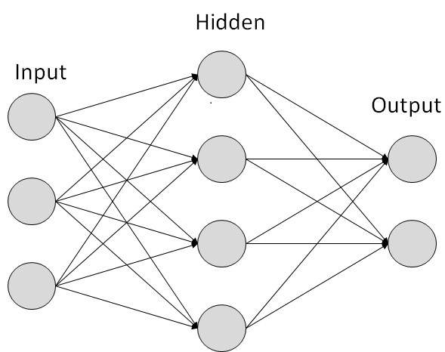
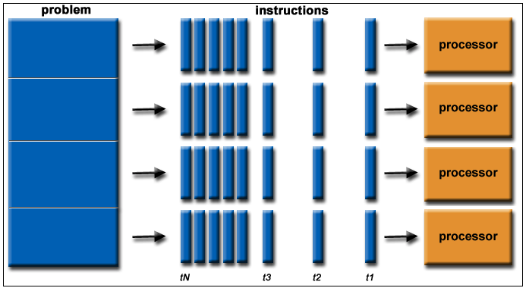
Non-Von Neumann Model
Other then Von-Neumann architectures
Ex. including neural networks (using ideas from models of the brain as a computing paradigm), genetic algorithms (exploiting ideas from biology and DNA evolution), quantum computation (previously discussed), and parallel computers. Of these, parallel computing is currently the most popular.
Arise Concept of Parallel computing
If a computer isn’t fast enough or powerful enough, instead of trying to develop a faster, more powerful computer, why not simply use multiple computers?

Slide 48
The Evolution of the Intel x86 Architecture
It is worthwhile to list some of the highlights of the evolution of the Intel product line:
• 8080: The world’s first general-purpose microprocessor. This was an 8-bit machine, with an 8-bit data path to memory. The 8080 was used in the first personal computer, the Altair.
• 8086: A far more powerful, 16-bit machine. In addition to a wider data path and larger registers, the 8086 sported an instruction cache, or queue, that prefetches a few instructions before they are executed. A variant of this processor, the 8088, was used in IBM’s first personal computer, securing the success of Intel. The 8086 is the first appearance of the x86 architecture.
• 80286: This extension of the 8086 enabled addressing a 16-MByte memory instead of just 1 MByte.
• 80386: Intel’s first 32-bit machine, and a major overhaul of the product. With a 32-bit architecture, the 80386 rivaled the complexity and power of minicomputers and mainframes introduced just a few years earlier. This was the first Intel processor to support multitasking, meaning it could run multiple programs at the same time.
• 80486: The 80486 introduced the use of much more sophisticated and powerful cache technology and sophisticated instruction pipelining. The 80486 also offered a built-in math coprocessor, offloading complex math operations from the main CPU.
• Pentium: With the Pentium, Intel introduced the use of superscalar techniques, which allow multiple instructions to execute in parallel.
• Pentium Pro: The Pentium Pro continued the move into superscalar organization begun with the Pentium, with aggressive use of register renaming, branch prediction, data flow analysis, and speculative execution.
• Pentium II: The Pentium II incorporated Intel MMX technology, which is designed specifically to process video, audio, and graphics data efficiently.

Slide 49
The Evolution of the Intel x86 Architecture
Pentium III: The Pentium III incorporates additional floating-point instructions to support 3D graphics software.
Pentium 4: The Pentium 4 includes additional floating-point and other enhancementsfor multimedia.8
Core: This is the first Intel x86 microprocessor with a dual core, referring to the implementation of two processors on a single chip.
Core 2: The Core 2 extends the architecture to 64 bits. The Core 2 Quad provides four processors on a single chip.
The x86 provides an excellent illustration of the advances in computer hardware over the past 30 years. The 1978 8086 was introduced with a clock speed of 5 MHz and had 29,000 transistors. A quad-core Intel Core 2 introduced in 2008 operates at 3 GHz, a speedup of a factor of 600, and has 820 million transistors, about 28,000 times as many as the 8086.Yet the Core 2 is in only a slightly larger package than the 8086 and has a comparable cost.

